Slide 1
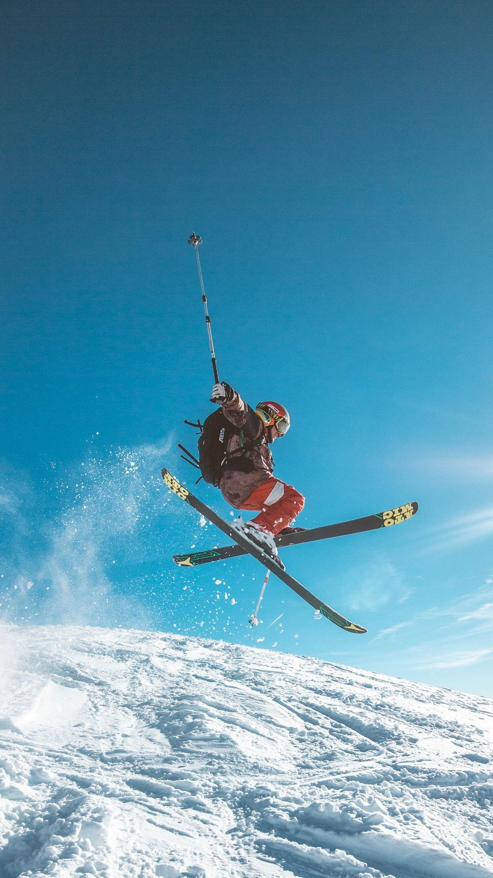
Peak Performance
A data-driven approach to adjusting our ticket prices to reflect the value we bring to customers

Slide 2
Problem Statement
Currently we base our price model off of simplified market averages.
We are not an average resort.
How can Big Mountain Resorts generate more profits by restructuring our price model to be based off of operational costs, facilities, and other competitive features?

Slide 3
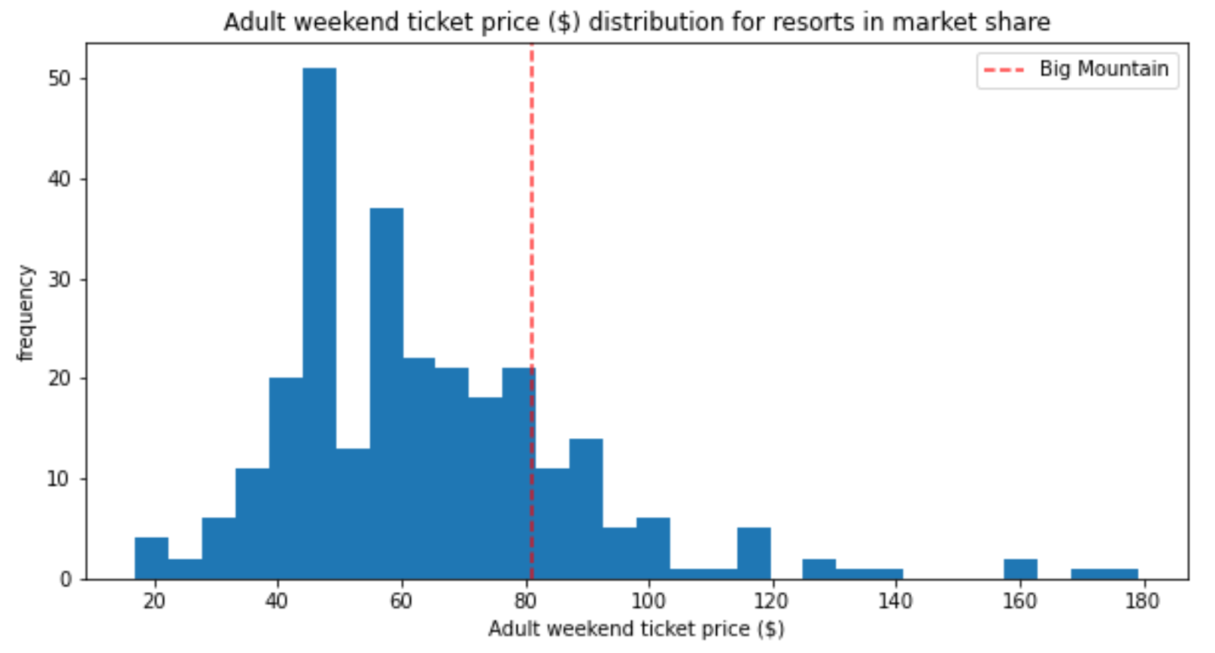
Market Prices
1
Market data is brought down by a substantial number of $45 and $55 ticket prices.
There are better ways to predict value!

Slide 4
Adjusted Prices, Commensurate To Our Services
We can increase our ticket prices by $8.61, to $89.61 by...
Adding a run
Increasing vertical drop by 150 feet
Installing an additional chairlift (which we already prepared to do)
By making three changes, we’ll gain an additional $15,065,471 over our operating season
This alone covers the operational costs of a new chairlift (~$1.54 million)

Slide 5
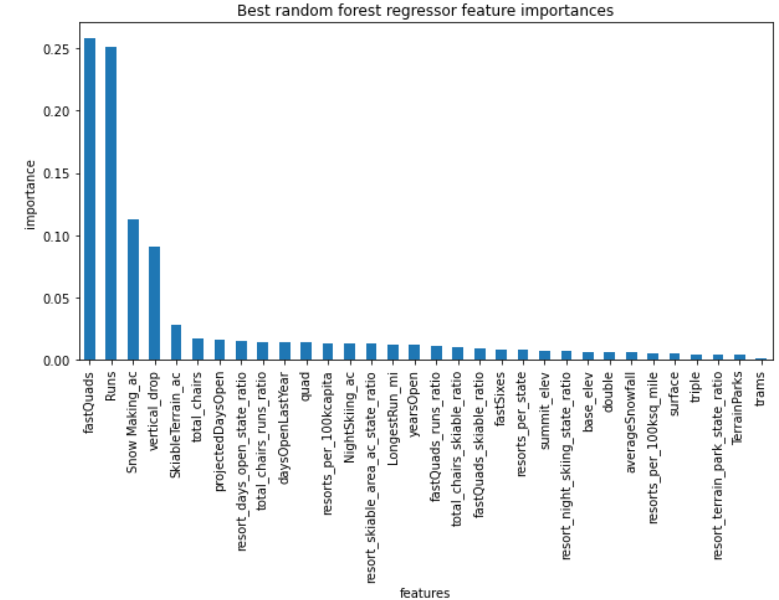
Feature importance
Customers will pay a premium for better features. Using random forest regression analysis, we’ve identified these four:
Number of fast quads
Number of runs
Area covered by snow making
Vertical drop

Slide 6
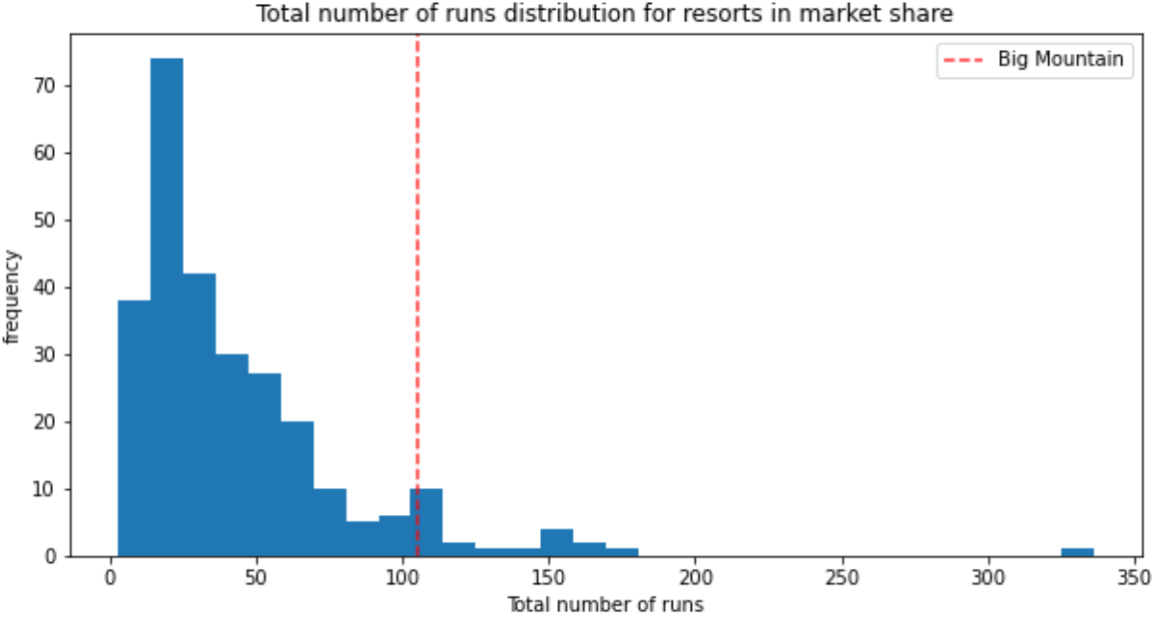
Adding A Run
We’re already ahead of the market in total number of runs
Number of runs accounts for nearly a quarter of ticket price variance. So adding just a single run increases our value substantially.

Slide 7
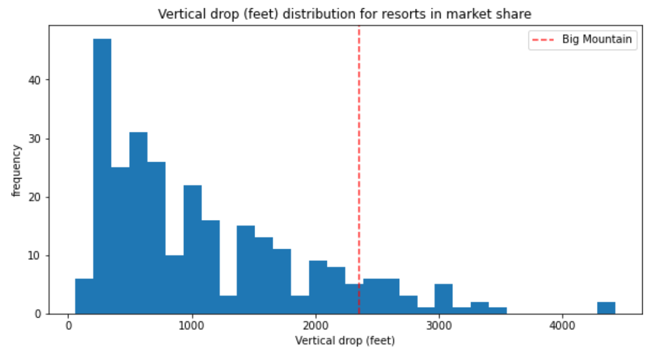
Vertical Drop
We’re clearly doing well with vertical drop
A few resorts are ahead of us, so it wouldn’t take much to nudge our vertical drop to a more competitive level and increase our price accordingly

Slide 8
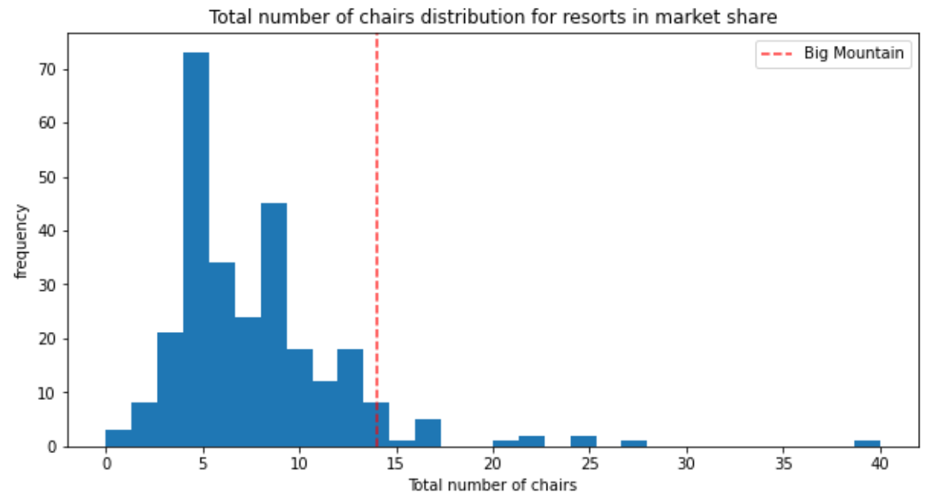
Chair Lifts
We currently have plans to add an additional chair lift.
As with these other features, we already are ahead of most other resorts. But adding just one will push us from “great” to “superior.”
Our proposed increase to ticket prices (+$8.61) more than covers our expected increase to operating costs (~$1.54 mil).

Slide 9
In Summary
Our current price model underestimates how much customers value different resort features.
We can increase our prices to $89.61 (+$8.61) by making these small changes:
Adding a single run
Increasing our vertical drop by 150 feet
Adding a new chairlift (which we already have plans to do)
These changes to prices will yield an additional $15,065,471 during our operating season.
This will more than pay for operating costs of our new chairlift (~$1.54 mil.) and ensure we’re making our prices commensurate with the features our customers value.

